Slide 1

Netflix Analysis
Nitin Dumka
INTERNSHIP_17546440516895be537820f

Slide 2

PROBLEM STATEMENT
Netflix has become one of the world’s largest streaming platforms, offering a wide range of movies and TV shows to millions of users worldwide. With such a massive and diverse content library, understanding what type of shows, genres, and ratings attract audiences is essential for business growth. This project aims to analyze Netflix’s dataset to identify patterns in content types, release years, countries, and ratings. By exploring these trends, the analysis helps understand Netflix’s content distribution and audience preferences over time.

Slide 3
Project Description The Netflix Data Analysis project focuses on exploring and understanding the patterns hidden within Netflix’s content catalog. Using Python and data visualization tools, this project analyzes different factors such as content type, release year, duration, rating, and country of origin. The goal is to uncover insights into how Netflix structures its library, which regions contribute the most content, and how trends have changed over the years. This analysis helps in understanding audience preferences, supporting data-driven decisions for future content planning and improving streaming recommendations.

Slide 4

WHO ARE THE END USERS?
The end users of this project include data analysts, business strategists, content managers, and marketing teams working in the entertainment or streaming industry. These users can utilize the insights from the analysis to understand audience preferences, identify popular genres, and plan content acquisition or production strategies. Additionally, students and researchers in data science can benefit from this project as a practical example of exploratory data analysis (EDA) using real-world data. The insights can also help Netflix competitors improve their content distribution and recommendation strategies.

Slide 5

Technology Used
The project is developed using Google Colab as the main environment for coding and analysis. The dataset is handled with Python, where libraries such as Pandas and NumPy are used for data cleaning and preparation. For data visualization and pattern discovery, tools like Matplotlib and Seaborn are applied to create charts and plots. Google Colab also enables easy integration with Google Drive for storing and accessing datasets. File Handling libraries for Openpyxl (for excel) and built in csv file handling. These technologies together provide a reliable and efficient setup for analyzing Netflix Data.

Slide 6
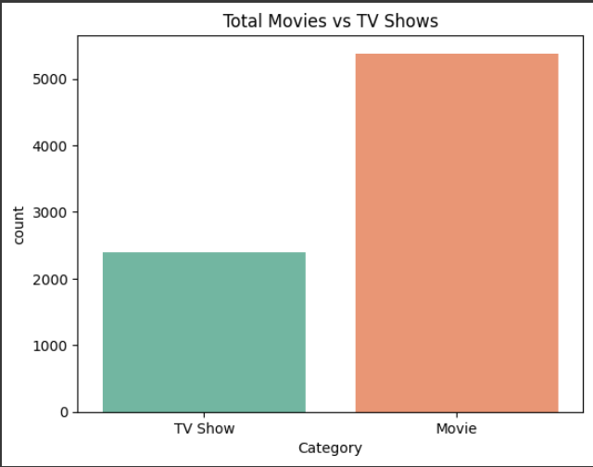
RESULTS1
Demo Link

Slide 7
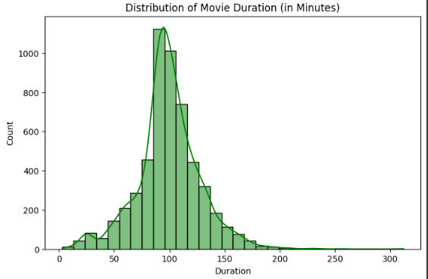
RESULTS2
Demo Link

Slide 8
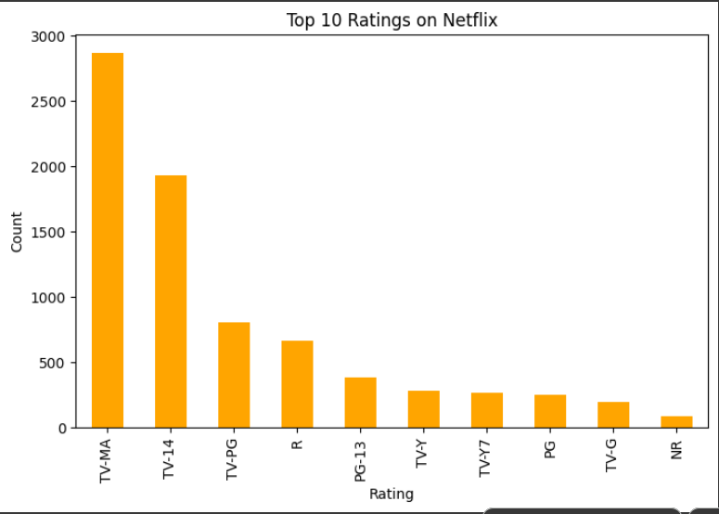
RESULTS3
[Add screen shots of your code or Chart(s) ]
Demo Link

Slide 9
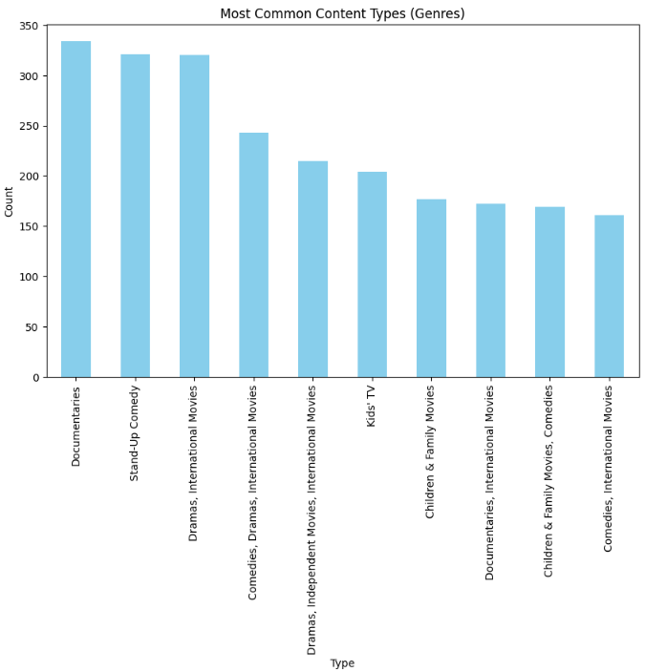
RESULT4

Slide 10
GitHub repository
Nitindumka123/VOIS_AICTE_OCT2025_Netflix_Analysis
Demo Link

Slide 11
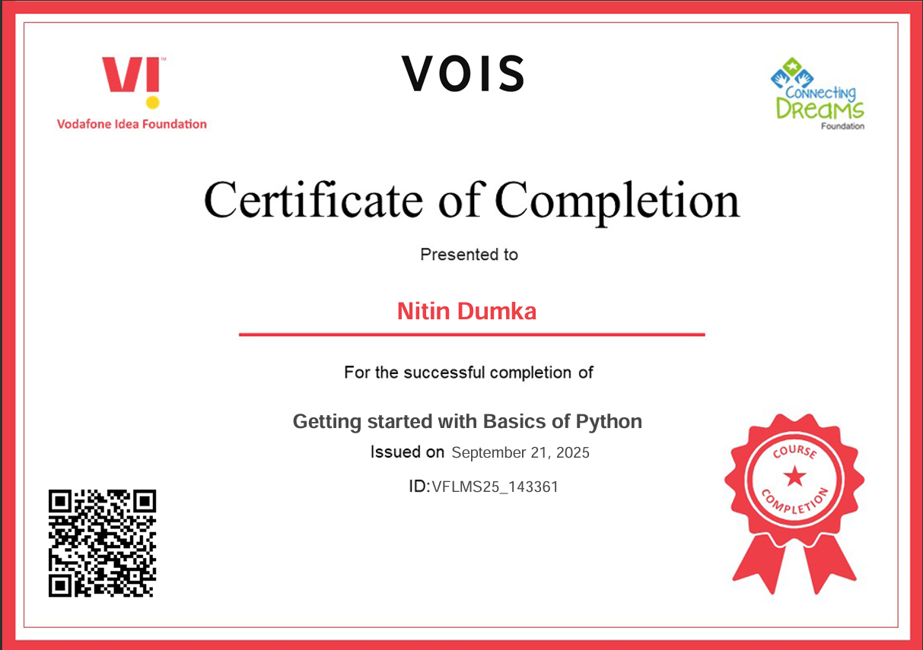
Getting started with Basics of Python Certificate

Slide 12
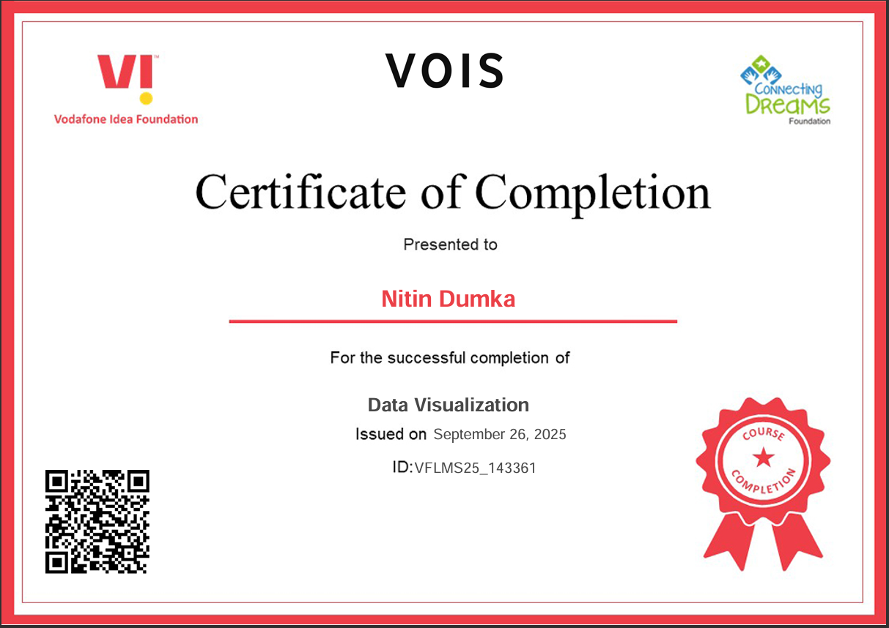
Data Visualization Certificate
[Paste your Certificate Here]

Slide 13
Thank you
.
.

